Slide 1

Shellcode Of Death
Payatu Labs
HackSys

Slide 2
root@kalu:~/# whoami
Ashfaq Ansari CEH
Security Consultant
Payatu Technologies Pvt. Ltd.
http://www.payatu.com/
http://hacksys.vfreaks.com/

Slide 3
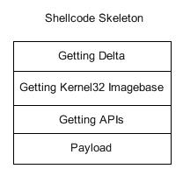
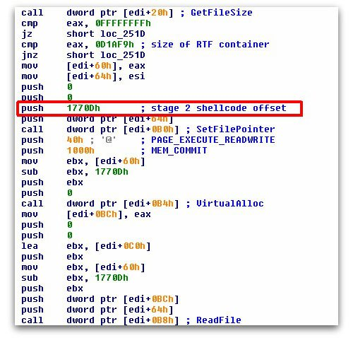
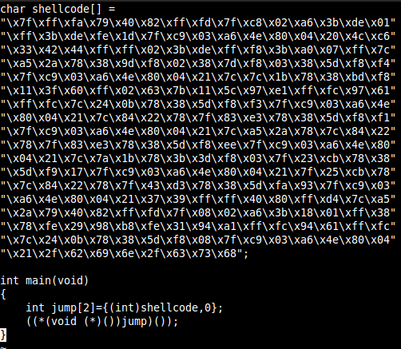

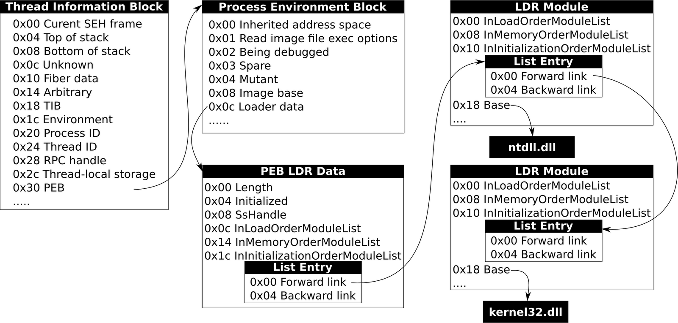
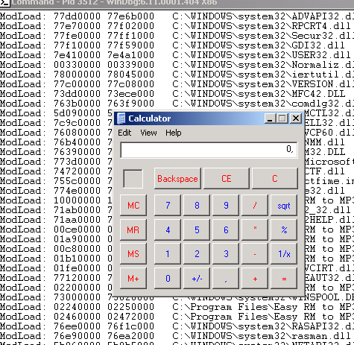
Agenda
Introduction to Shellcode
Types of Shellcode
Shellcode Of Death
Why Shellcode Of Death?
Demo
QA

Slide 4



Introduction to Shellcode
Wikipedia
Small piece of code used as the payload in the exploitation of a software vulnerability.
http://en.wikipedia.org/wiki/Shellcode
Basically
Set of assembly instructions developed to perform specific task like binding to a port, etc. after exploiting a software vulnerability.
History of Shellcode
Shellcodes were used to spawn a command shell on the victims Computer running vulnerable program. Hence, it was named as Shellcode.
Modern Age
Writing a Shellcode in this age depends on writers creativity and the state of mind.

Slide 5

Types of Shellcode

Slide 6

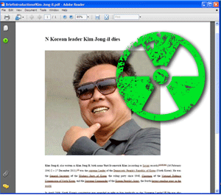







Local Shellcode
OWNED!
~exploit.tmp
Vulnerability Triggered Exploitation Done Shellcode Executed
ShellCode

Slide 7

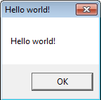
Remote Shellcode
Exploit + Shellcode
OWNED!
Vulnerability Triggered Exploitation Done Shellcode Executed
ShellCode

Slide 8

Download and Execute Shellcode
Any Medium
OWNED!
Vulnerability Triggered Exploitation Done Shellcode Executed
ShellCode

Slide 9

Egg-Hunt Shellcode
Process Memory
Heap
Any Medium
ShellCode
OWNED!
Stack
Egg-hunt ShellCode
Vulnerability Triggered Exploitation Done Shellcode Executed

Slide 10
Shellcode Of Death

Slide 11

DO NOT TRY THIS ON A PRODUCTION COMPUTER!
This shellcode has been developed for educational purpose only. The author is not and will not hold any responsibility for any illegal, unauthorized or the damaged caused by the use of #ShellcodeOfDeath. Any use of this shellcode is at the reader’s own risk.
WARNING

Slide 12
Formats all the available drive on Windows.
Designed to run on Windows x86 platform.
Wicked Sunny. Not for production Computers.

Slide 13
Why Shellcode Of Death?

Slide 14

Microsoft does not provide any documented Windows API to properly FORMAT a drive.

Slide 15

Mark Russinovich - www.sysinternals.com
VOID NTAPI
FormatEx(
IN PWCHAR DriveRoot,
IN FMIFS_MEDIA_FLAG MediaFlag,
IN PWCHAR Format,
IN PWCHAR Label,
IN BOOLEAN QuickFormat,
IN ULONG ClusterSize,
IN PFMIFSCALLBACK Callback)
Exposed an undocumented Windows API that can be used efficiently to format a drive in Windows NT systems. The “FormatEx” API is exported from “fmifs.dll” and the DLL is located in System32 directory.

Slide 16
Demo Time to be wicked Sunny.

Slide 17
Resources
GitHub
HackSys Team
https://github.com/hacksysteam/ShellcodeOfDeath
https://hacksys.vfreaks.com/
Payatu Technologies
Shellcode Of Death
http://www.payatu.com/
http://hacksys.vfreaks.com/research/shellcode-of-death.html

Slide 18
Questions
hacksysteam@hotmail.com
https://facebook.com/HackSysTeam
@HackSysteam

